Slide 1
Introduction to neuroscience
Lecture 3

Slide 2
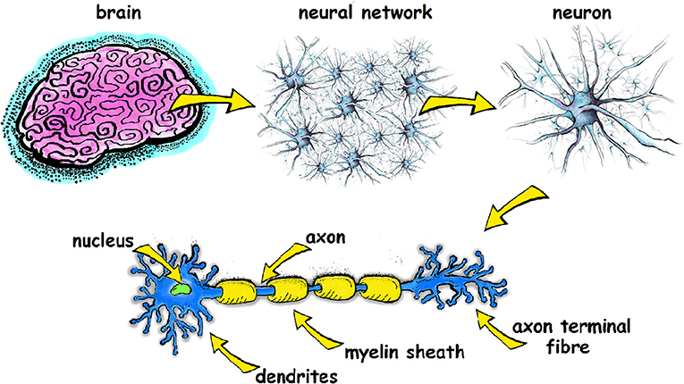
neuroanatomy
Brain Nucleus/

Slide 3
Psychoactive drugs alter brain chemistry and signaling
Acute: hijack the normal brain circuitry to “activate” or “inhibit” brain cells
Chronic: influence homeostasis
Both effects can ultimately change behaviour… but how does this happen?

Slide 4
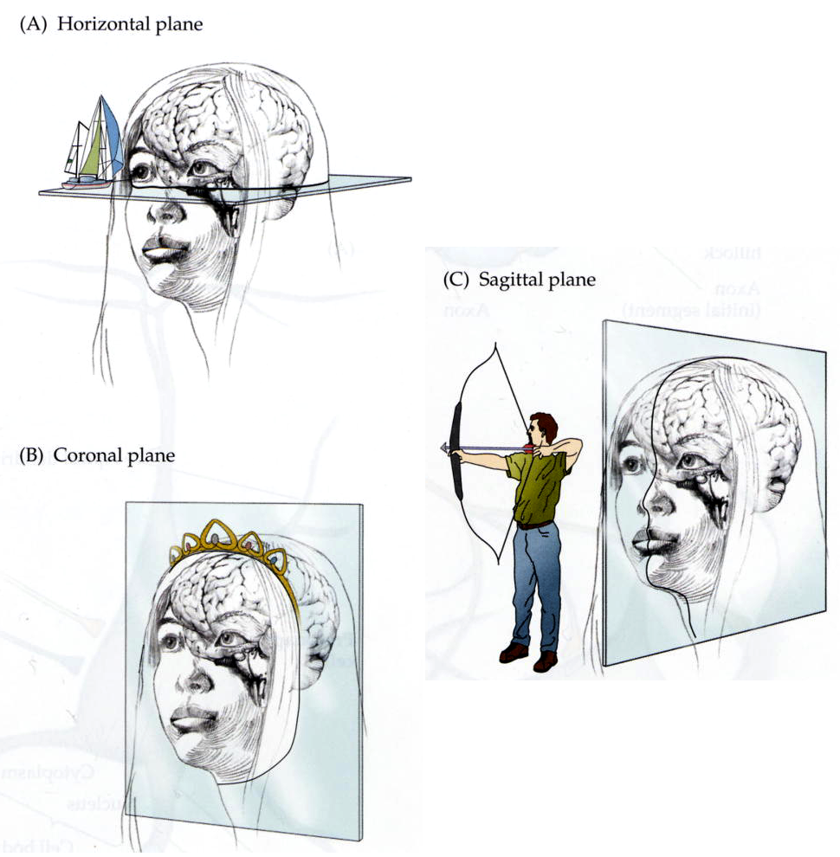
Common planes of brain sections: A) horizontal B) coronal C) sagittal
Notes:
B- can also be frontal

Slide 5
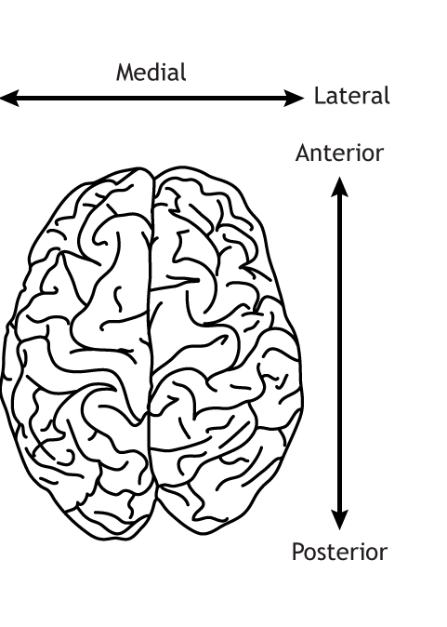
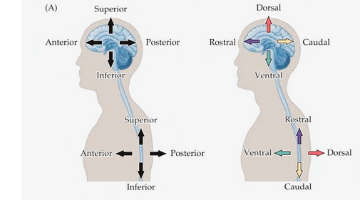
Anatomical terms of direction
Notes:
Note: what is chosen sometimes differs depending whether it’s comparative and human anatomy

Slide 6
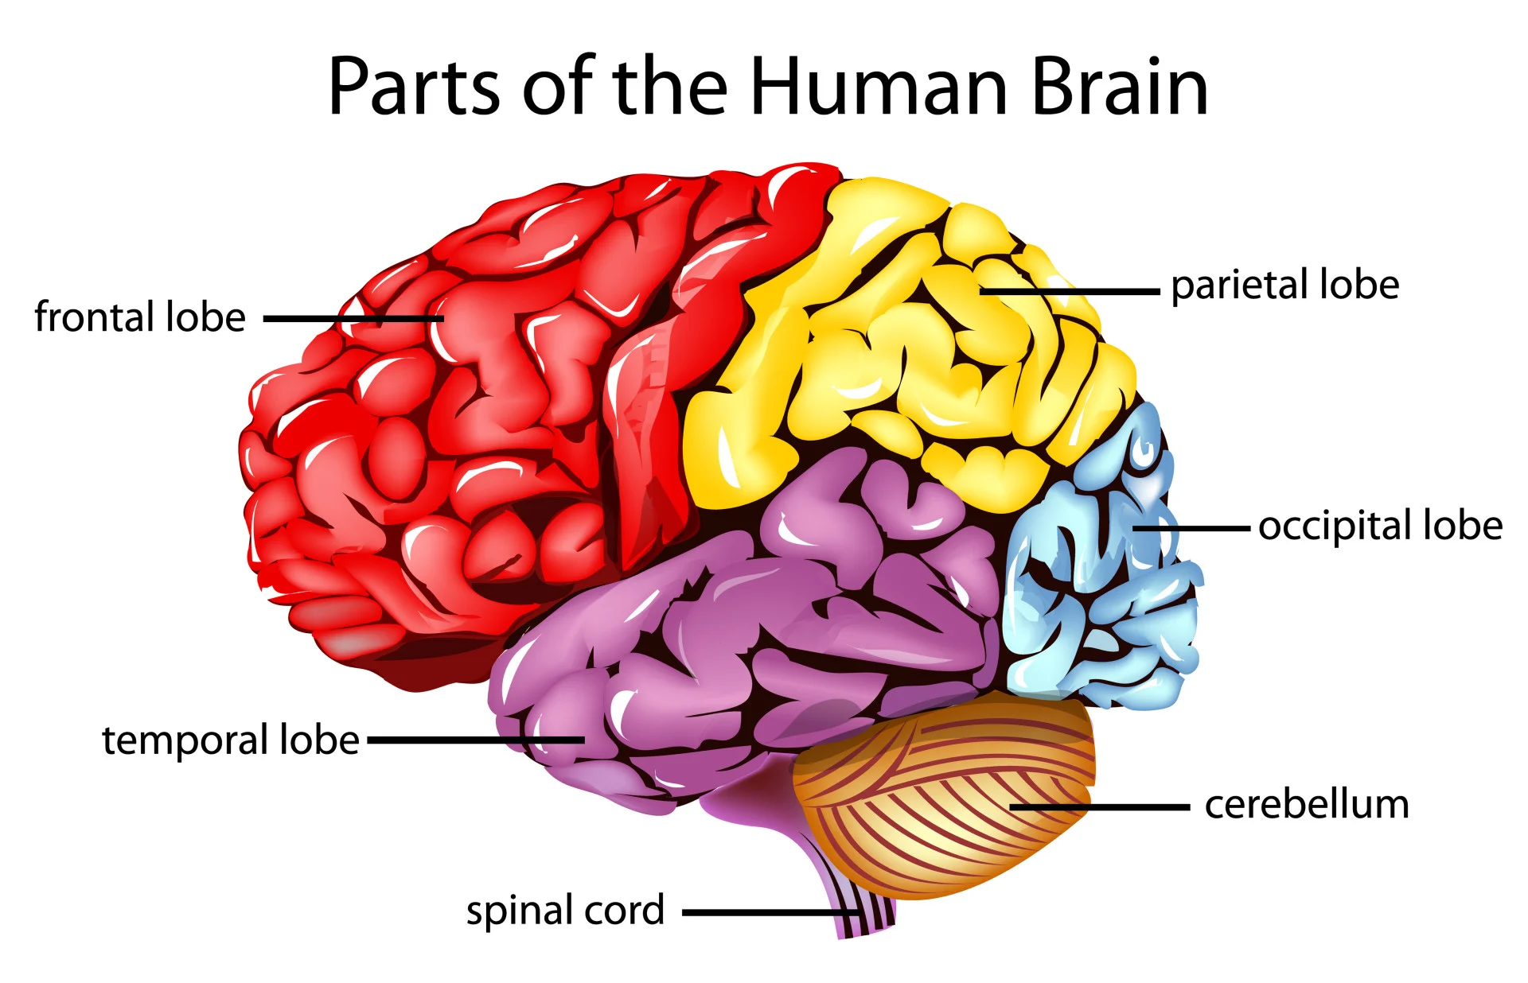
Lobes of the human brain
The cortex has 4 primary lobes
Let’s Review: https://www.youtube.com/watch?v=LQ4DlE1Xyd4
Notes:
Gyri (singular: gyrus) are the folds or bumps in the brain and sulci (singular: sulcus) are the indentations or grooves

Slide 7
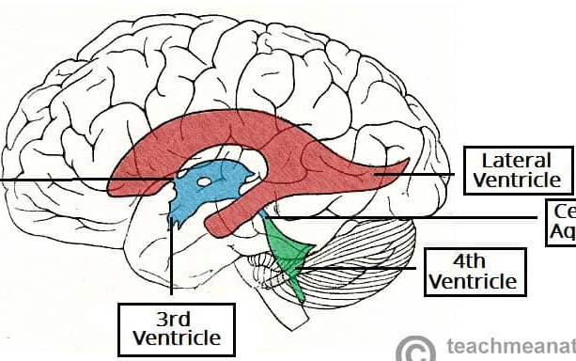
ventricles
Def: a hollow part or cavity
four connected fluid-filled cavities in the brain through which cerebrospinal fluid circulates

Slide 8
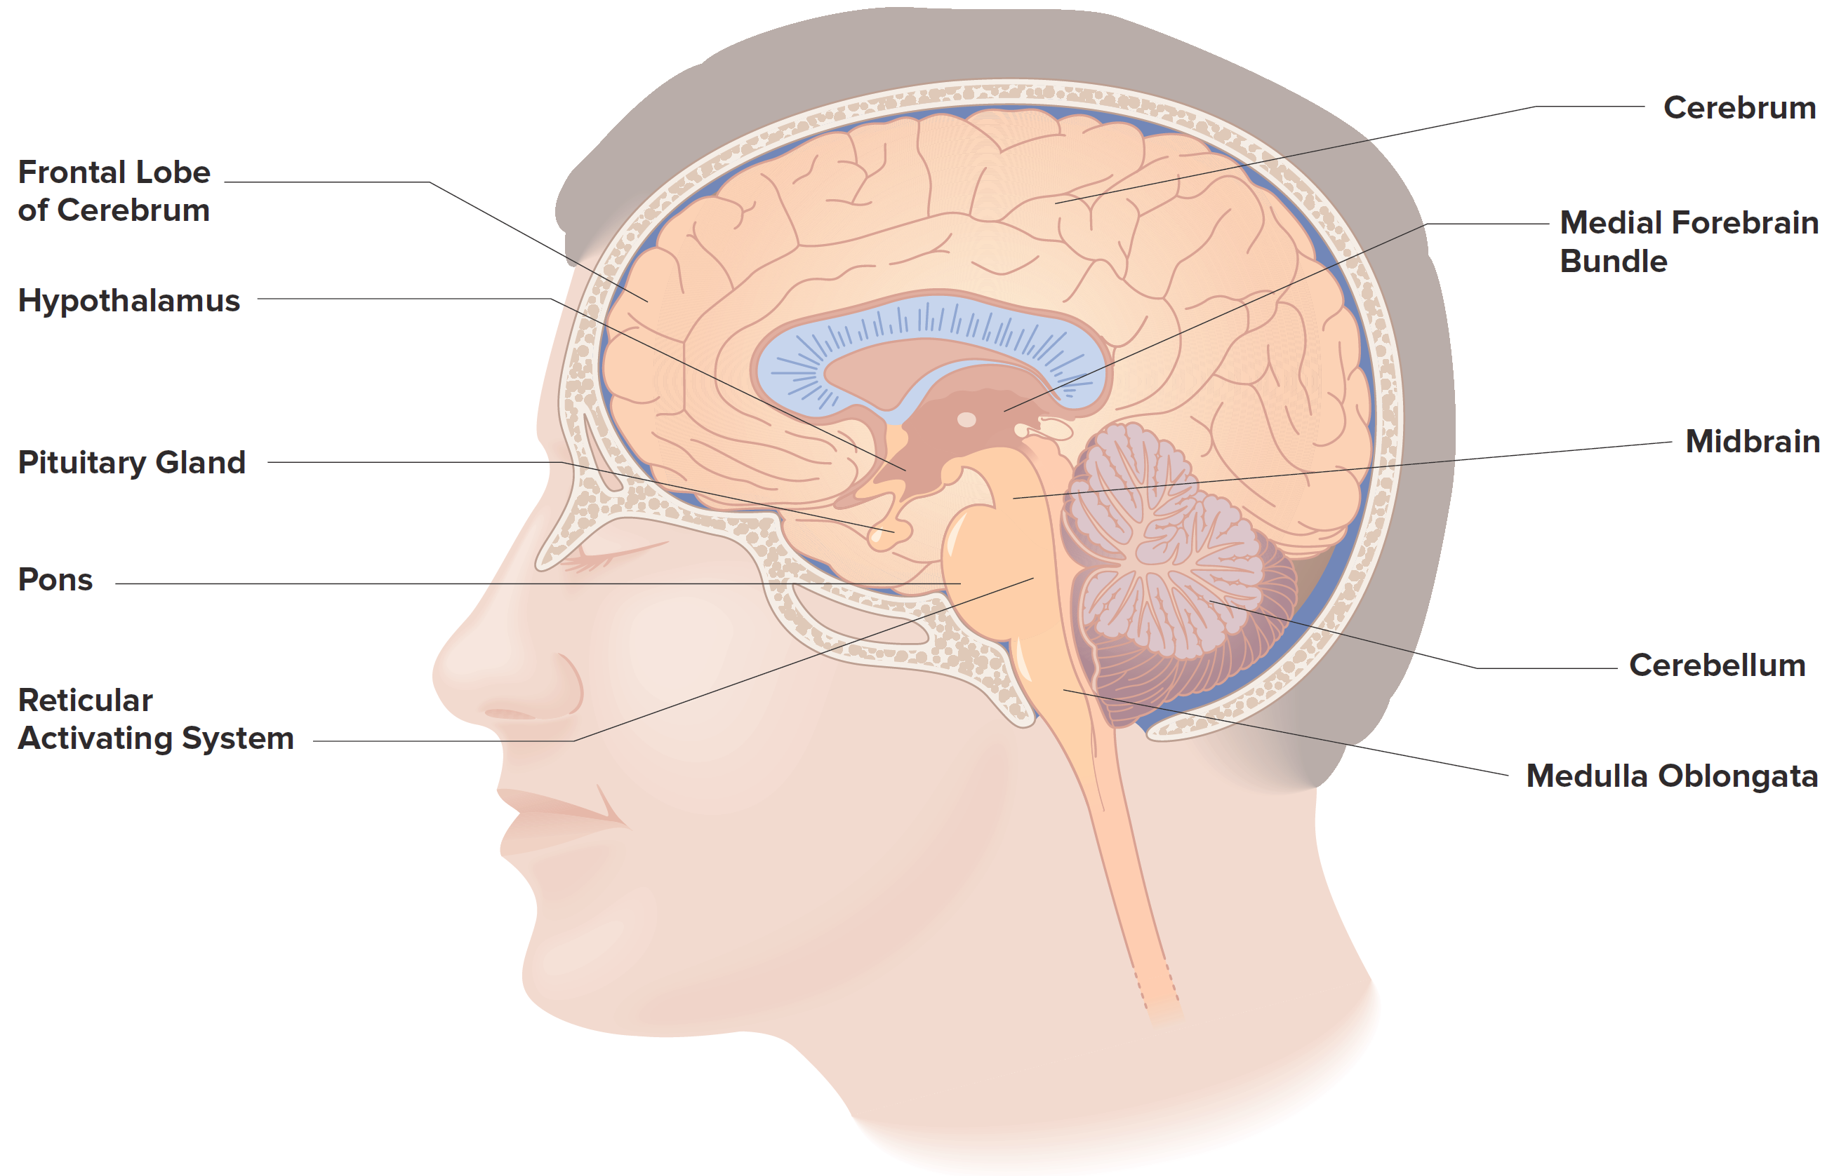
the human Brain: Major Structures/Regions
Corpus Callosum
(Cortex)
(Prefrontal Cortex)
Thalamus
Lateral Regions
Hippocampus
Amygdala
Figure 4.4

Slide 9
the human Brain: Functions of Major Structures/Regions
Cortex –
Cerebellum –
Spinal cord –
Thalamus –
Hypothalamus –
Pituitary gland –
Midbrain –
Pons –
Medulla oblongata –
Hippocampus –
Amygdala –
Notes:
This is just a spot for you to take notes so you don’t have to use the previous slide!

Slide 10
neuroanatomy
Brain Nucleus/

Slide 11
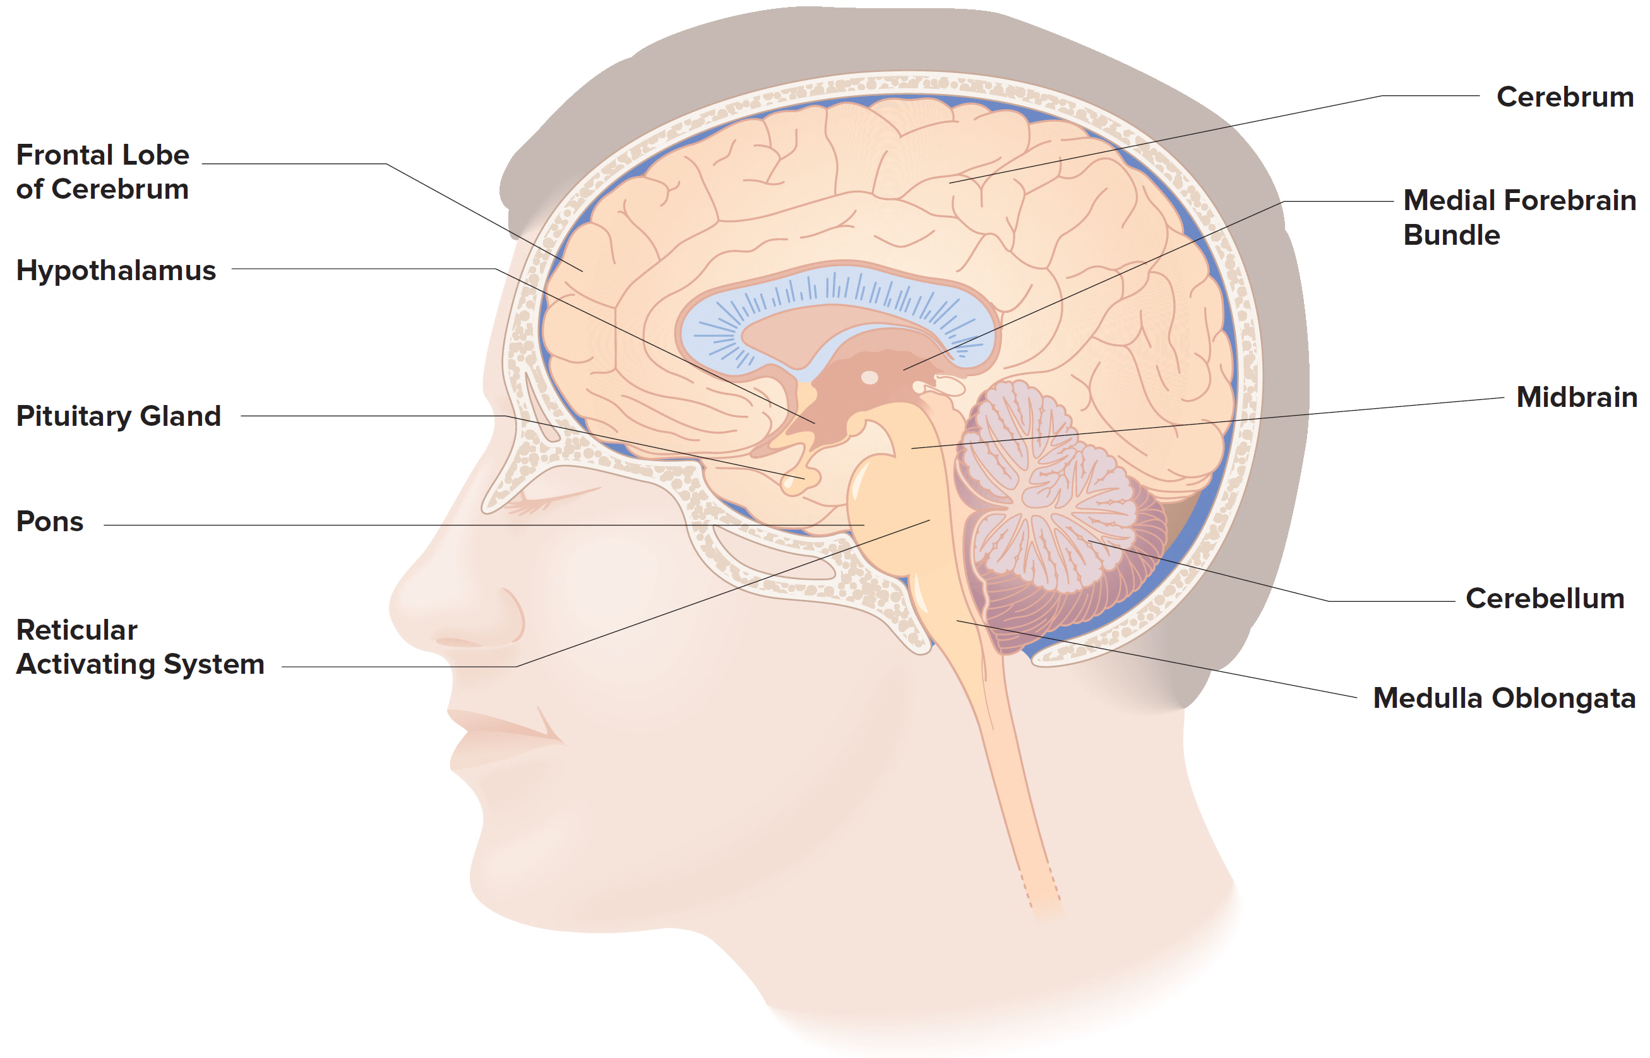
the Brain: critical Nuclei for drugs effects
In neuroanatomy, a nucleus
(pl. : nuclei) is a cluster of neurons, located deep within the cerebral cortex and brainstem.
The neurons within one nucleus usually have roughly similar connections and functions.

Slide 12
the Brain: Key Nuclei
Substantia Nigra
VTA - Ventral Tegmental Area
Locus Coeruleus
Dorsal Raphe
(ignore any black lines without →)
Notes:
FYI – your book shows some of these with Figure 4.3

Slide 13
neuroanatomy
Brain Nucleus/

Slide 14
Components of the brain and Nervous System
Two major types of cells in the nervous system.
1) Neurons, or nerve cells.
2) Glia, or glial cells.
There are ~100,000,000,000 of each type of these brain cells!

Slide 15
Glia
Major functions: (generally)
Providing structure and support to the brain.
Getting nutrients into the system.
Eliminating waste.
Forming myelin.
Communicating with other glia.
Maintaining the blood–brain barrier

Slide 16
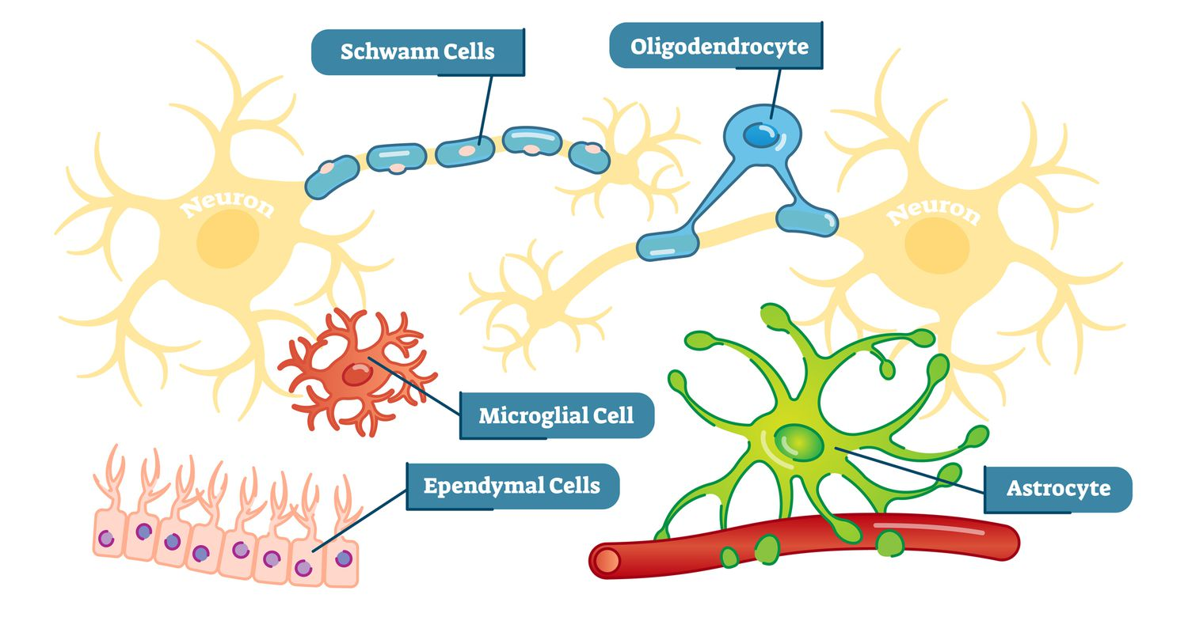
Glia (5 “types”*)
Notes:
*Arguable, but these are the major ones

Slide 17
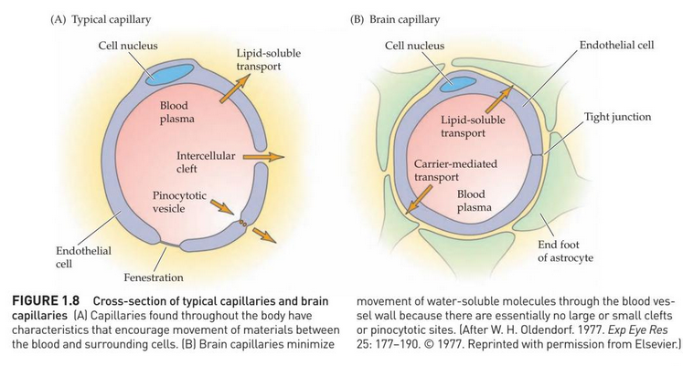
Astrocytes create the blood brain-barrier
The blood–brain barrier – a semi-permeable membrane protecting the brain from toxic chemicals.
A drug molecule must be able to pass through the barrier to be psychoactive.
Notes:
Helpful video, has more detail than you need though!: https://www.youtube.com/watch?v=e9sN9gOEdG4

Slide 18
Neurons
Primary cells of the nervous system that analyze and transmit information.
Defined regions:
Cell body.
Contains the processes that maintain the life of the neuron, including the nucleus.
Dendrite.
Contains receptors that respond to chemical signals.
Axon.
Specializes in transmitting signals to other neurons.
Axon terminal.
Contains synaptic vesicles that store neurotransmitters.

Slide 19
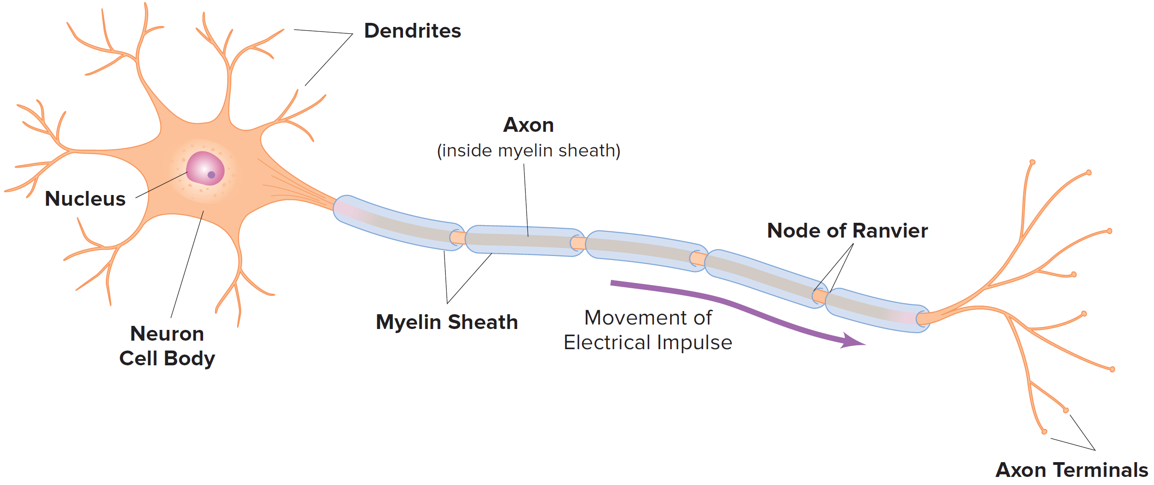
Figure 4.1: Neurons have: Cell Body, Dendrites, Axon, and Axon Terminals

Slide 20
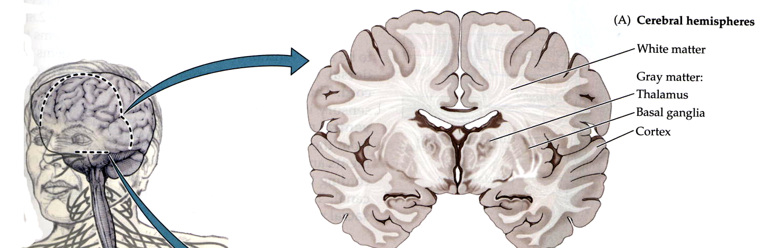
White matter (axons, myelin) and gray matter (cells)

Slide 21
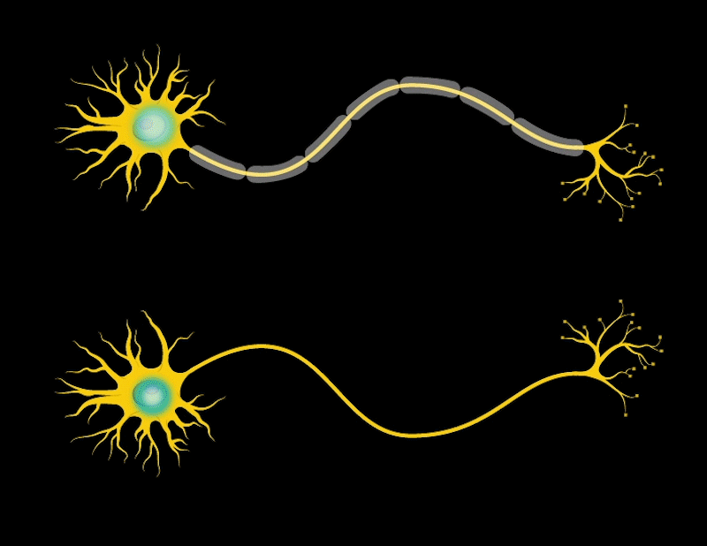

Neurons have Action Potentials
An Action potential is, put most simply, a neuron “firing”
What is actually happening is a brief, very fast electrical signal is transmitted along the axon.
This signal is considered “all-or-none” – aka the neuron fires or it doesn’t
How does an Action Potential, or neural firing occur?

Slide 22
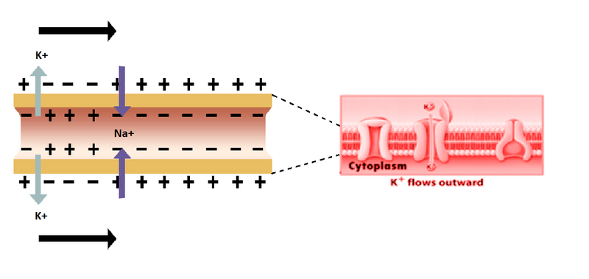
Neurons are polarized!
This is caused by an uneven distribution of charged Na⁺ and K⁺ ions between the outside and inside of a neuron
Na
Na
Before a neuron fires, it is simply “resting” in a hyperpolarized state (aka there is a greater negative charge on the inside of the neuron than the outside.)
We call this “Resting potential”
Axon
K
Notes:
*(and a few other factors you don’t need to know for this class)

Slide 23
How does an action potential happen? (aka, how does a neuron “fire”?)
K
Na
Na
Na+ Ion channels on the neuron open.
Allows ions to move inside the cell, causing it to depolarize.
If the cell is depolarized to a threshold of excitation, an action potential occurs and the neuron fires!
Notes:
Trying reading it without the word potential if you get confused. “What happens during neural “action”?”

Slide 24
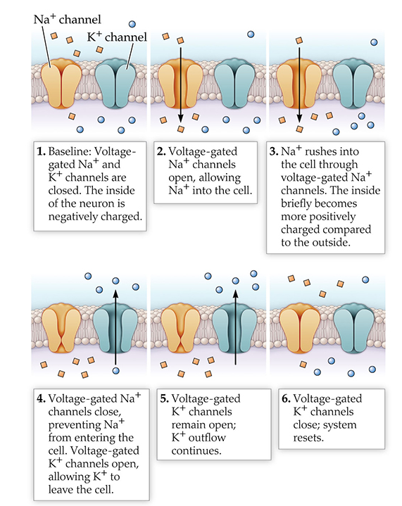

Slide 25
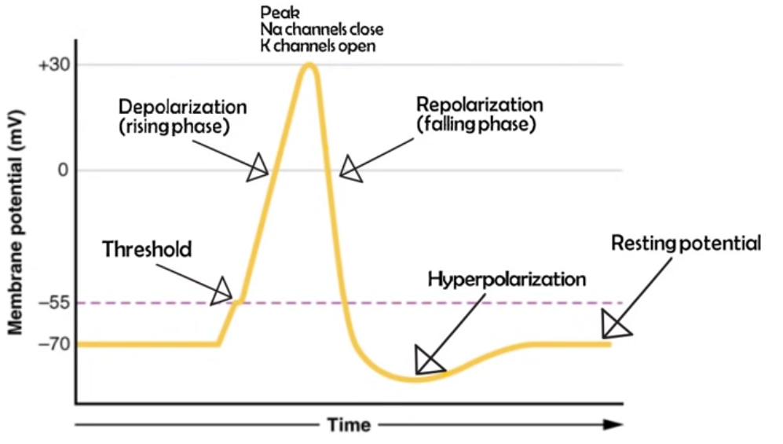
Ionic movement and membrane potentials
We can chart these changes in membrane potentials during neural firing as a measure of time vs. voltage!
Notes:
https://www.youtube.com/watch?v=W2hHt_PXe5o – just for reference, again, more detail than you need to know

Slide 26
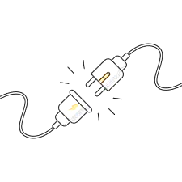
The Synapse and Neurotransmission
Neurotransmission - transferring information from one neuron to another at a synapse
Occurs via an action potential causing the release neurotransmitter into the synapse.
Presynaptic Neuron
Synapse
Postsynaptic Neuron

Slide 27
What is a neurotransmitter?
Neurotransmitters are endogenous chemicals that allow neurons to communicate with each other throughout the body.
Critical/major ones to know are:
1) Dopamine (DA)
2) Norepinephrine (NE)
3) Serotonin (5-HT)
4) Acetylcholine (ACh)
5) GABA
6) Glutamate (Glut)
7) Peptide hormones (incl. endogenous opioids)
8) Endocannabinoids
Notes:
Types? Many.

Slide 28
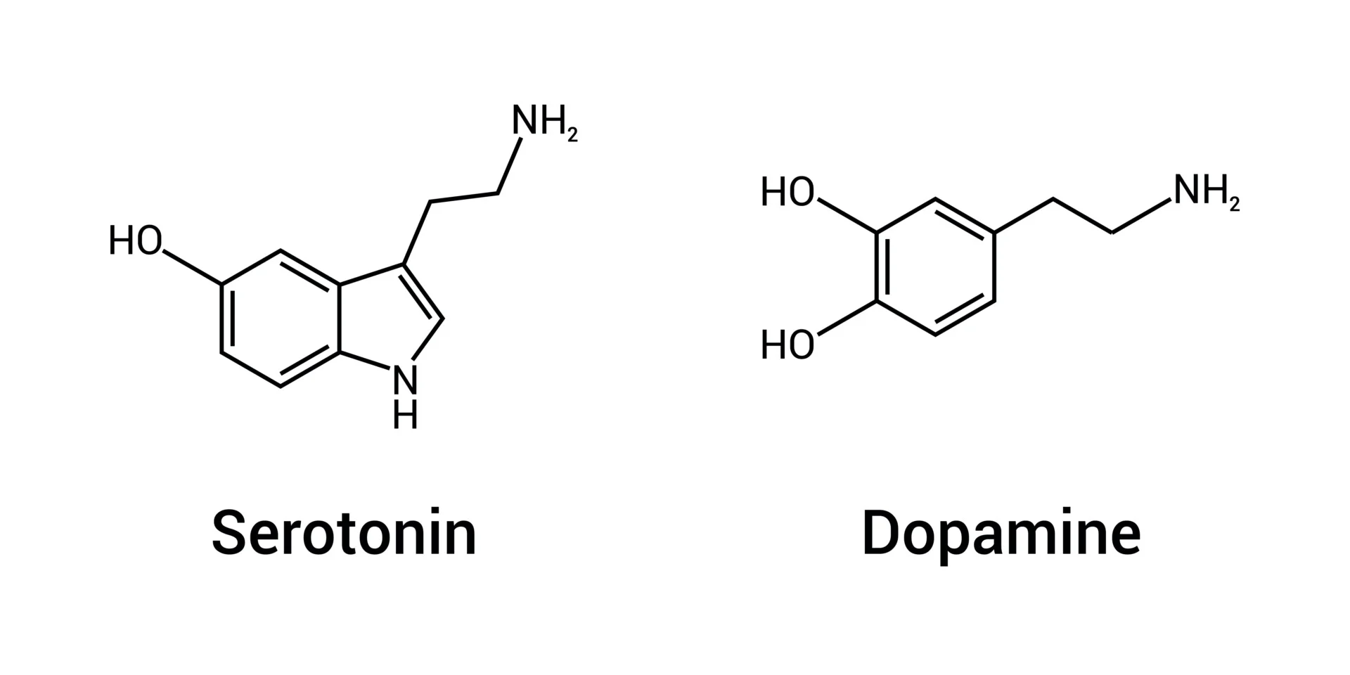
Ultimately the action potential results in release of neurotransmitter into the synapse
= a chemical signal
Think of the whole action potential process as one that converts an
electrical signal (the action potential) into a chemical signal (neurotransmitter release)

Slide 29
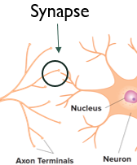
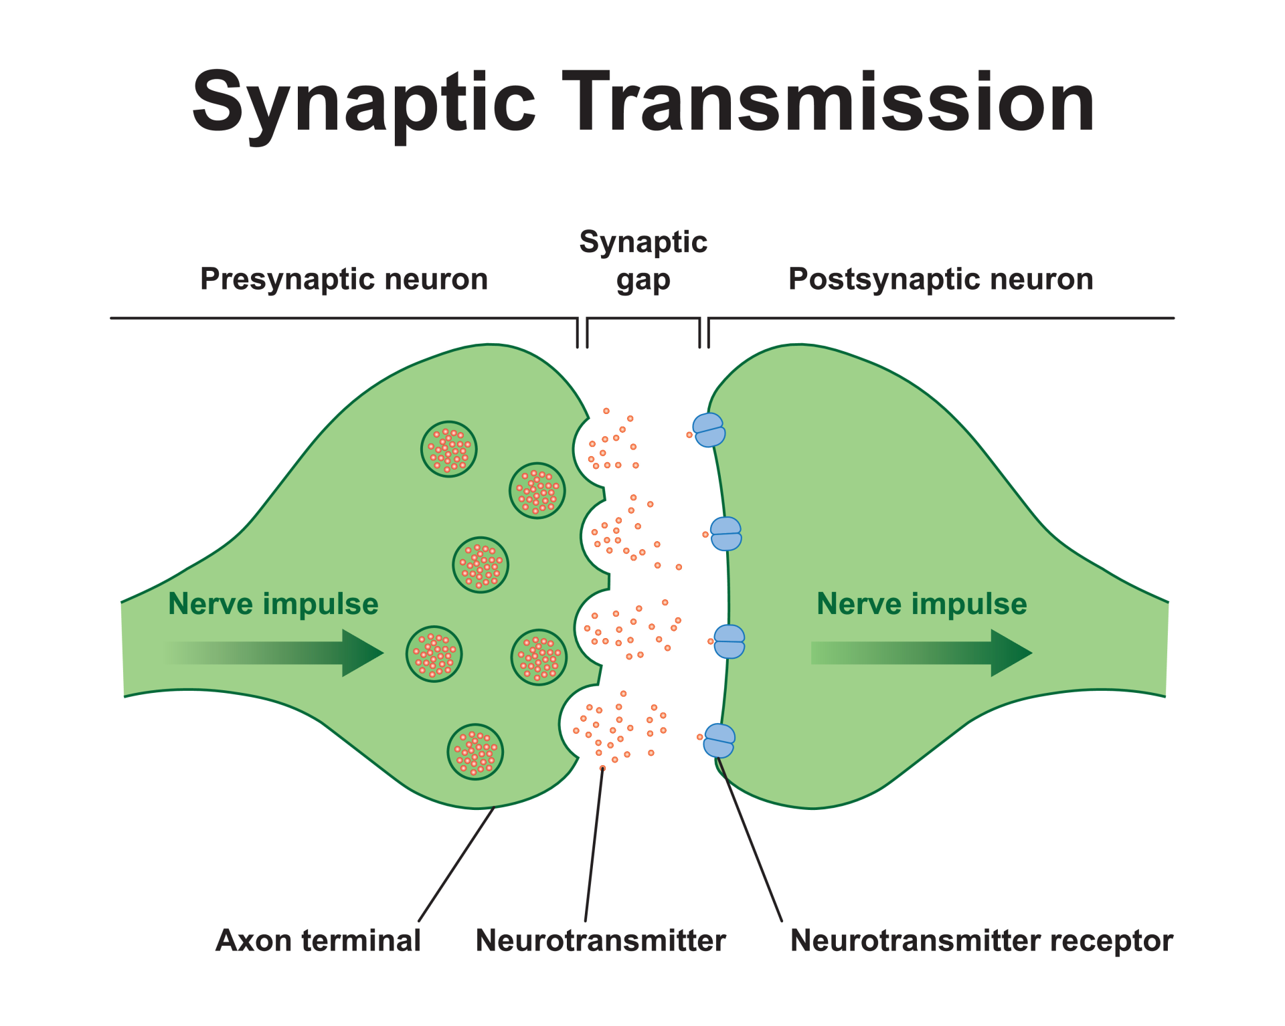
…Action potential?
Action potential!
…maybe…

Slide 30
Excitatory vs. inhibitory neural signaling
When neurotransmitter is released by one neuron, that neurotransmitter can make the next neuron either more or less likely to have an action potential.
Excitatory postsynaptic potential (EPSP): neurotransmitter causes next neuron to be more likely to fire
Also known as a depolarization
Inhibitory postsynaptic potential (IPSP): neurotransmitter causes the next neuron to be less likely to fire
Also known as a hyperpolarization
When a neurotransmitter binds its receptor, this ends the process of the chemical signal.
Notes:
To summarize - https://www.youtube.com/watch?v=6qS83wD29PY

Slide 31
Neurotransmission

Slide 32
Chemical Theories of Behavior historically
Many attempts have been made to explain normal variations in behavior in terms of changes in brain and body chemistries.
Historical precedents included…

Slide 33
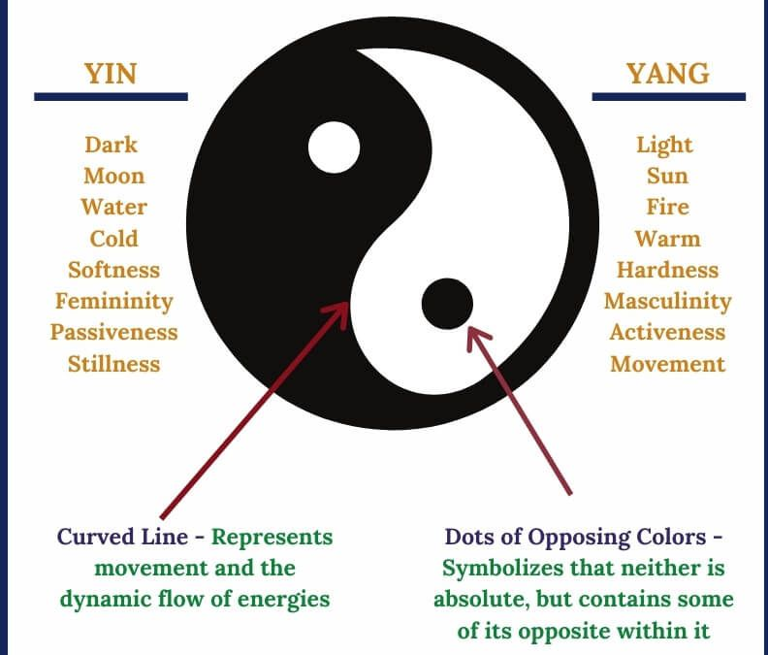
Chemical Theories of Behavior
Chinese philosophy of yin and yang.

Slide 34
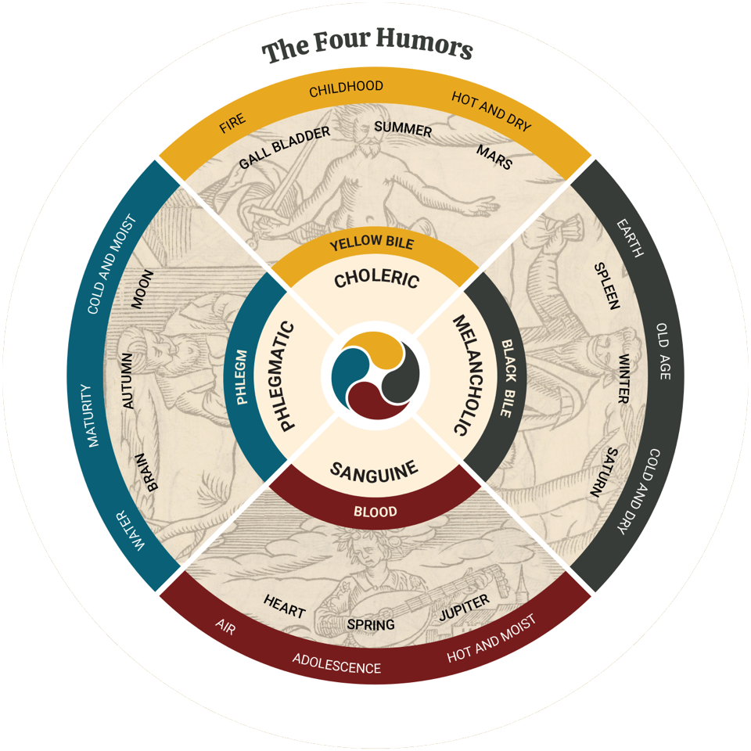
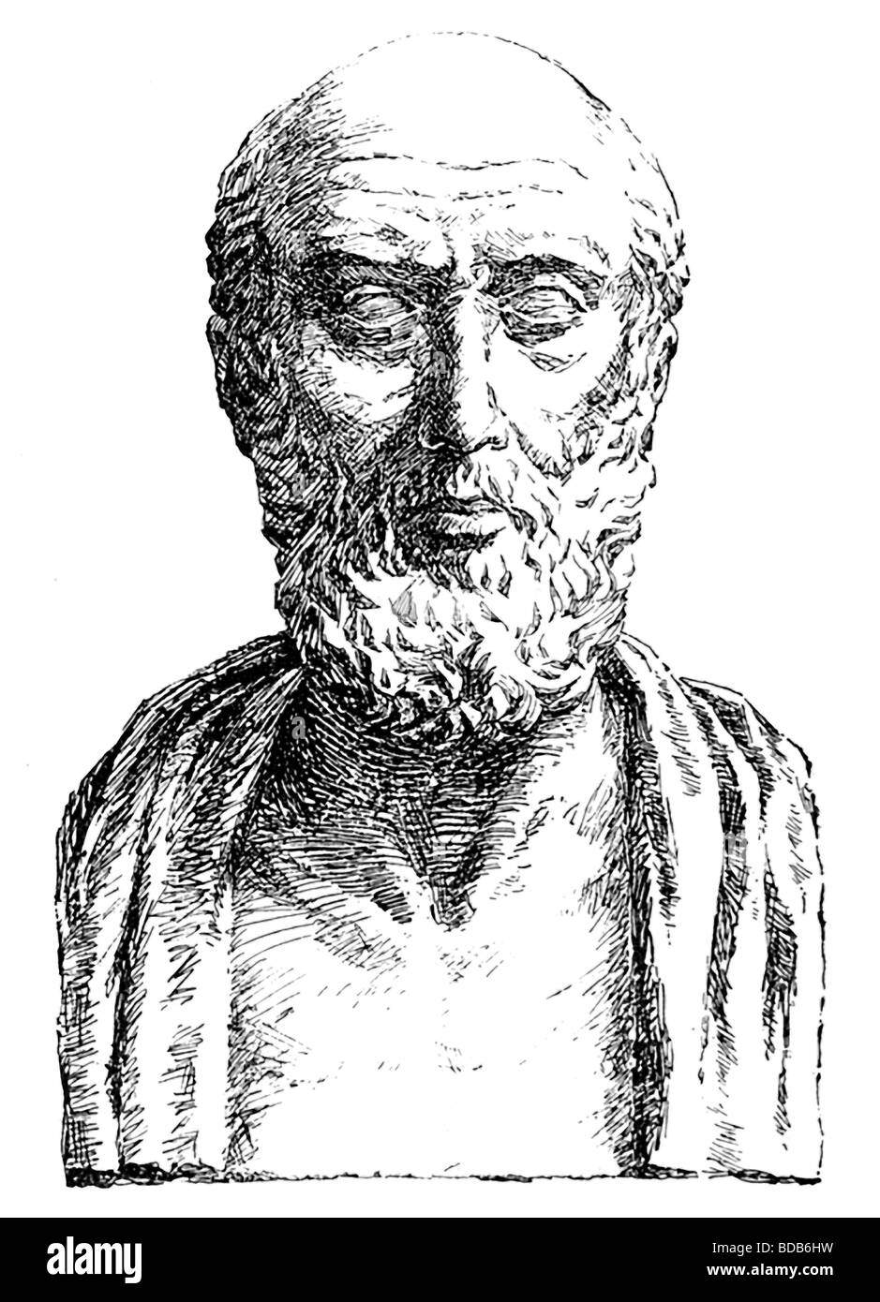
Chemical Theories of Behavior
Greek physician Hippocrates and the four humors: blood, phlegm, yellow bile, and black bile.

Slide 35
Chemical Theories of Behavior – Modern Day
Neuropharmacology
What is pharmacology?
“The science of drugs”
Greek words
pharmakos, refers to a poisoner, a magician, or a sorcerer
Evolved to later mean “a magical substance”
logos, ‘to study’
Why neuropharmacology?
Notes:
Neuropharmacology – the scientific study of drugs that affect the brain and/or nervous system

Slide 36
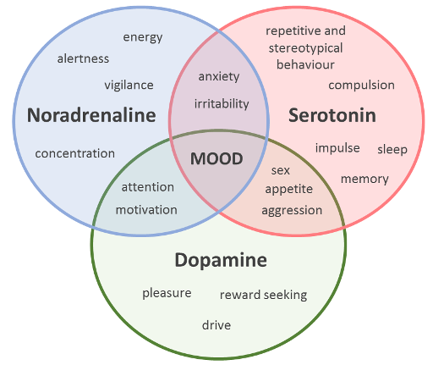
Chemical Theories of Behavior
The major theory guiding the clinical treatment of neuropsychological disorders hinges upon the fact that disruptions or dysregulation of neural activity in the monoamine neurotransmitters can alter mood and behavior.

Slide 37
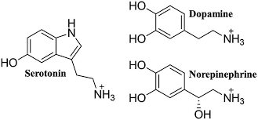
Chemical Theories of Behavior – Modern Day
“monoamines”
1) Dopamine (DA)
2) Norepinephrine (NE)
3) Serotonin (5-HT)
4) Glutamate (Glut)
5) GABA
6) Acetylcholine (ACh)
7) Peptide hormones (incl. endogenous opioids)
8) Endocannabinoids
“catecholamines”

Slide 38
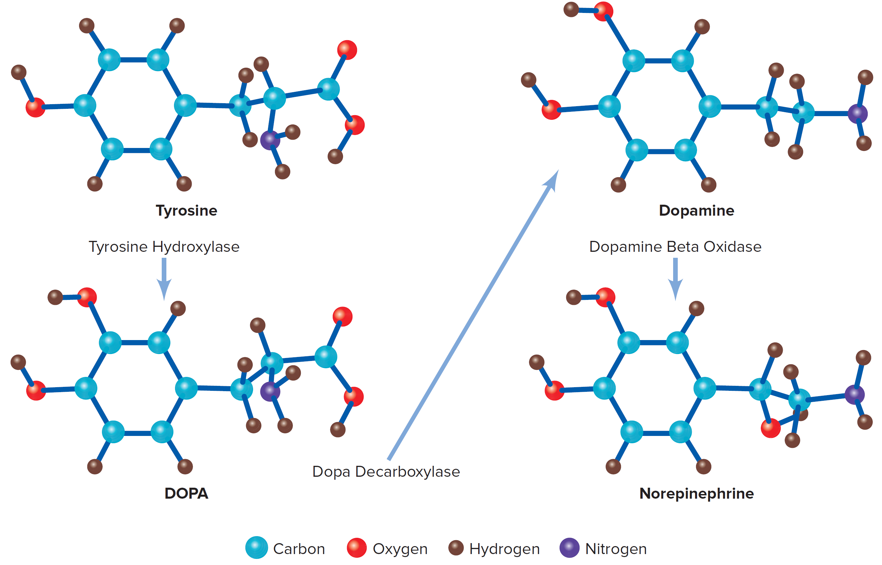
Generation of Neurotransmitters
Neurotransmitter precursors are found circulating in the blood supply and in the brain.
certain selected precursors are taken up by neurons, then stored in synaptic vesicles.
Catecholamine synthesis of the neurotransmitters Dopamine and Norepinephrine
Notes:
Tyrosine (amino acid)

Slide 39
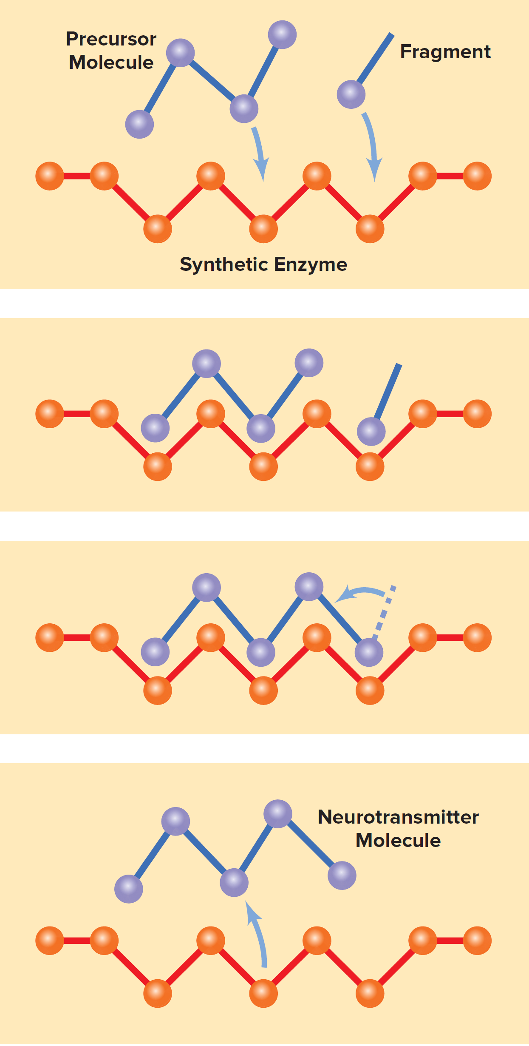
Life Cycle of a Neurotransmitter
Step 1: Uptake/Synthesis.
Precursors are synthesized into neurotransmitters through the actions of enzymes.
Step 2: Storage.
Neurotransmitters are stored in synaptic vesicles near the terminal from which they will be released.
For monoamines, done via the “vesicular monoamine transporter” or “VMAT” enzyme

Slide 40
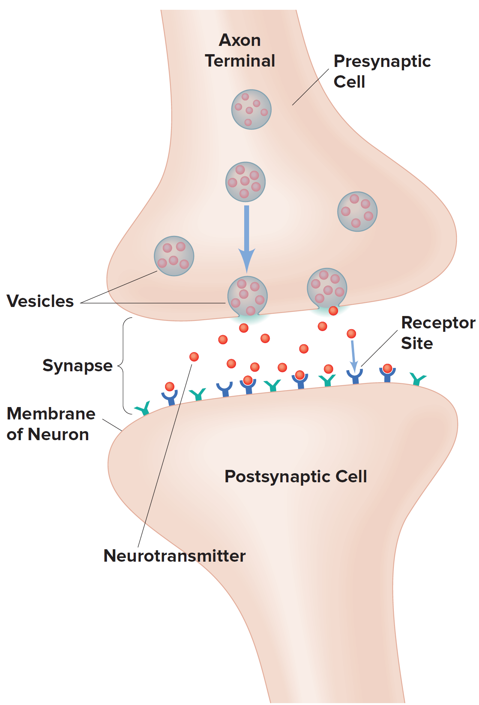
Life Cycle of a Neurotransmitter
Step 3: Release.
When the action potential arrives, neurotransmitters are released into the synapse.
Autoreceptors
Autoreceptor – (presynaptic) help to self regulate the amount of neurotransmitter released
Binding to the autoreceptors tells the neuron to halt synthesis and release – a homeostatic feedback loop!

Slide 41
Life Cycle of a Neurotransmitter
Step 4: Binding.
Released neurotransmitters bind with receptors on the membrane of the postsynaptic cell.
Neurotransmitters may have excitatory or inhibitory effects depending on the type of receptor.

Slide 42
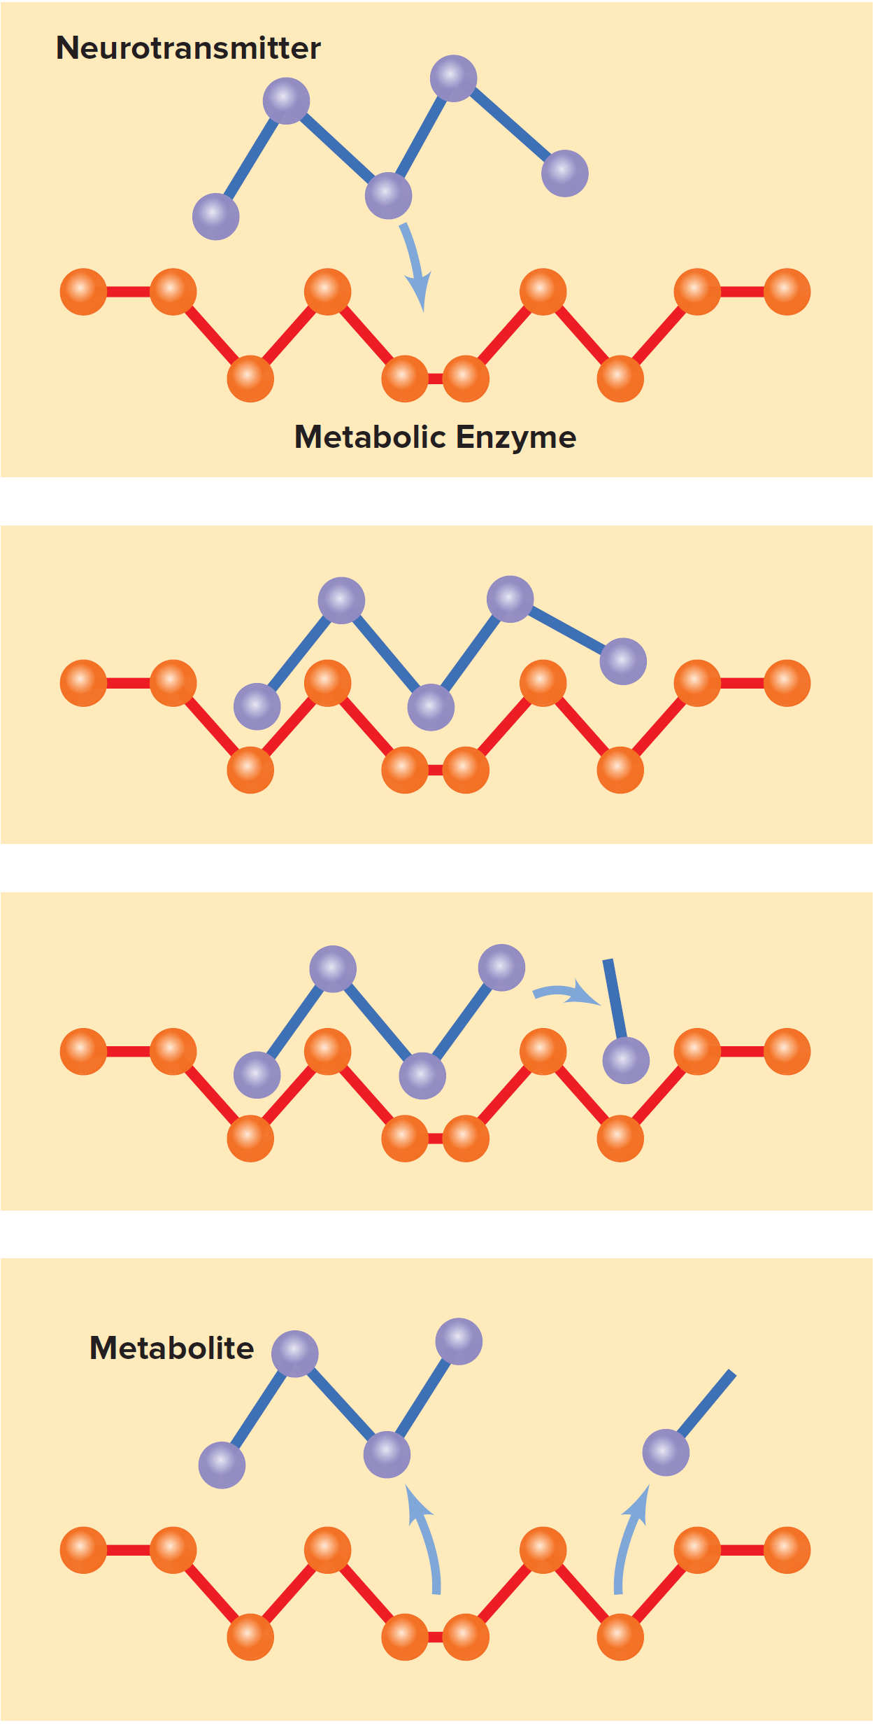
Life Cycle of a Neurotransmitter
Step 5: Metabolism.
Once a signal has been sent, neurotransmitters are removed from the synapse.
Two major enzymes to know in this breakdown process:
MAO – monoamine oxidase
COMT – Catechol-O-methyltransferase

Slide 43
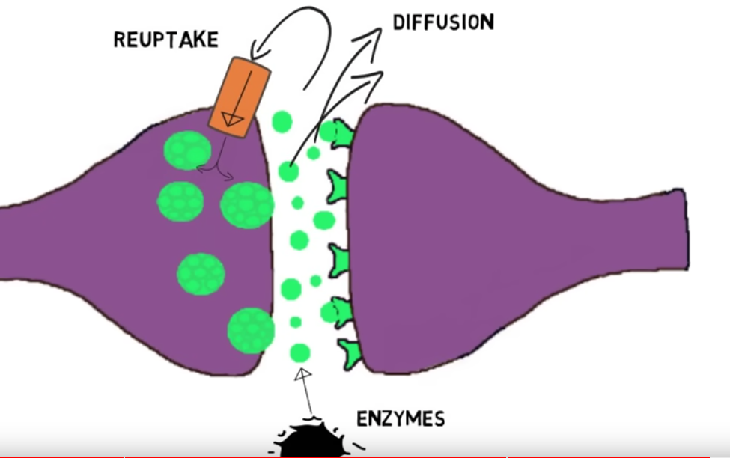
Neurotransmitter degradation and reuptake
https://www.youtube.com/watch?v=WhowH0kb7n0

Slide 44
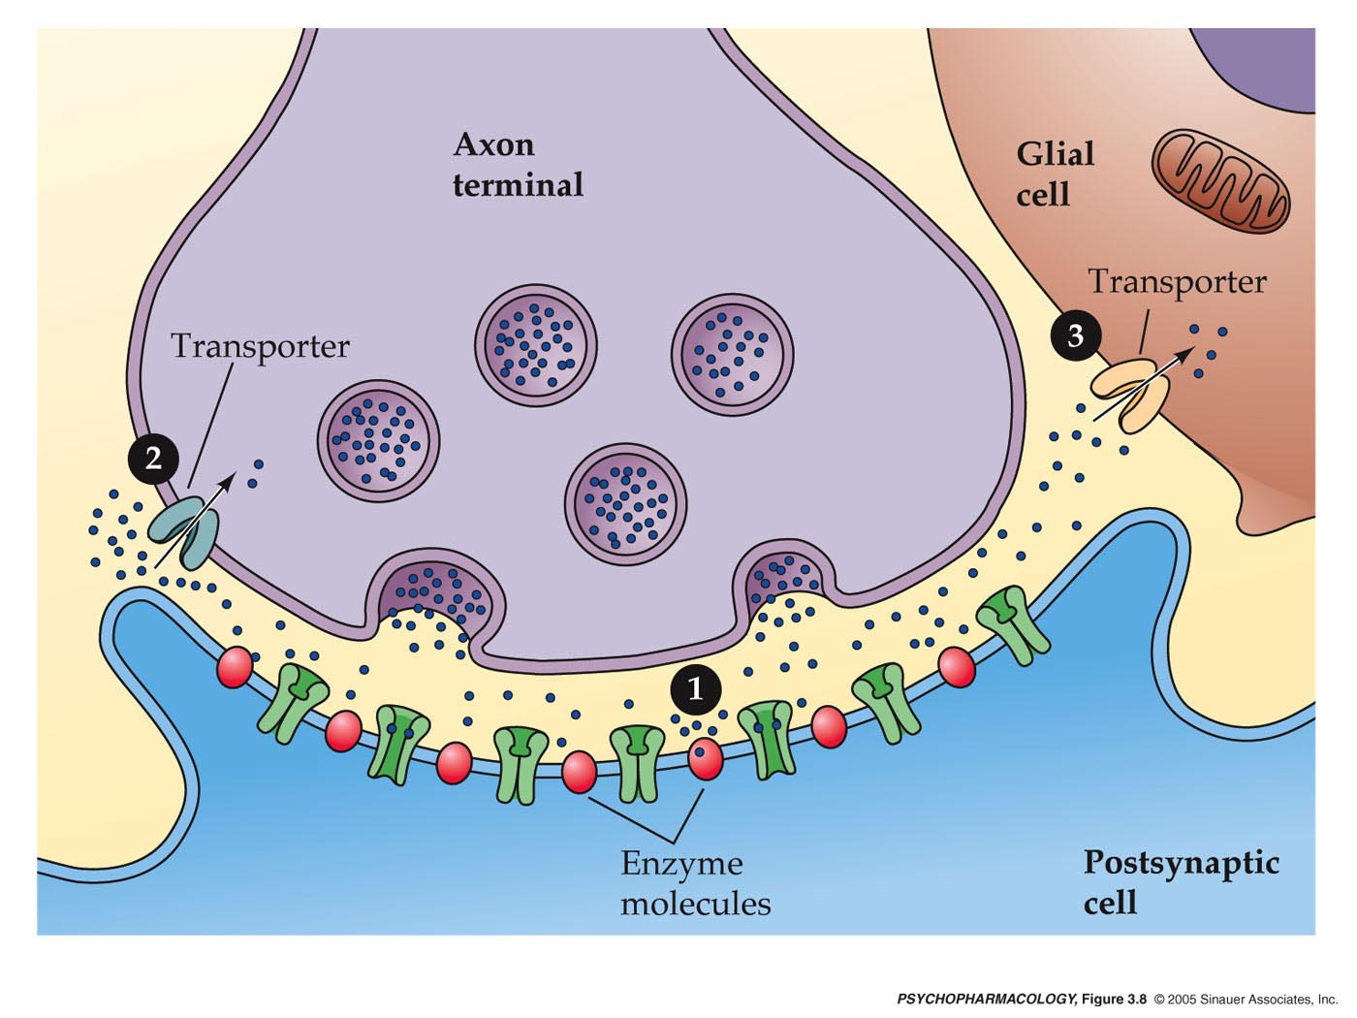
Life Cycle of a Neuro-transmitter 5 major “steps” for neurotransmitter signaling at a synapse…
1. Neurotransmitter Synthesis
Presynaptic cell
2. Packaging into vesicles
5A. Termination: re-uptake by transporter
Zoomed in at the synapse…
3. Release
Receptor
5B. Termination: enzyme degradation
4. Binding to receptor

Slide 45
Why do we care so much about neurotransmitters?
MOST drugs act (i.e., exert their function) at sites where neurotransmitters act!
Notes:
Or mimic their functions!

Slide 46
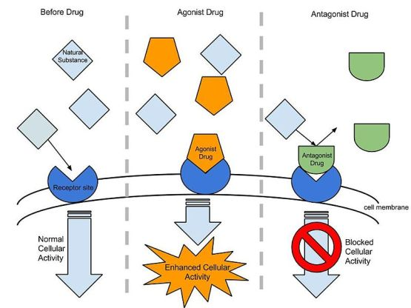
Drugs at the synapse - Key terms
Ligand: activating molecule (i.e., drug)
agonist mimics the action of neurotransmitters by activating the receptor.
antagonist occupies the receptor and prevents the neurotransmitter from activating it.
neurotransmitters

Slide 47
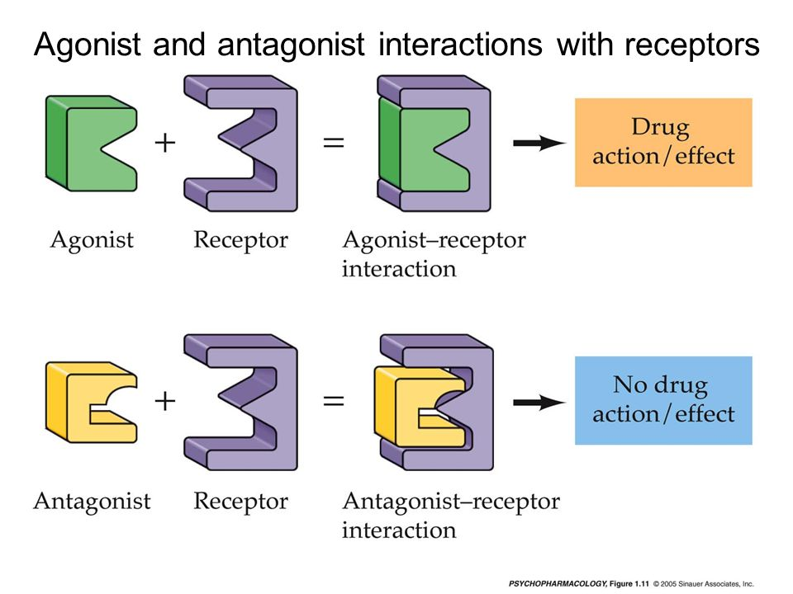

Slide 48
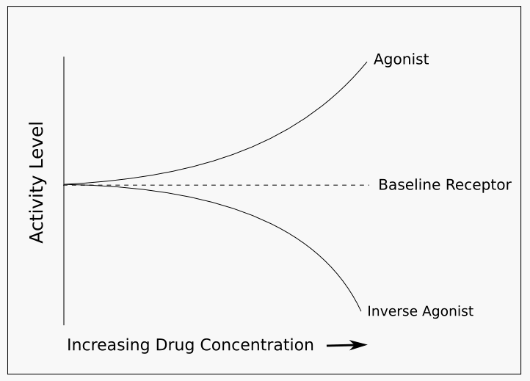
Notes:
What if I said you could also have a partial agonist? Or a partial inverse agonist?
Where would an antagonist be?

Slide 49
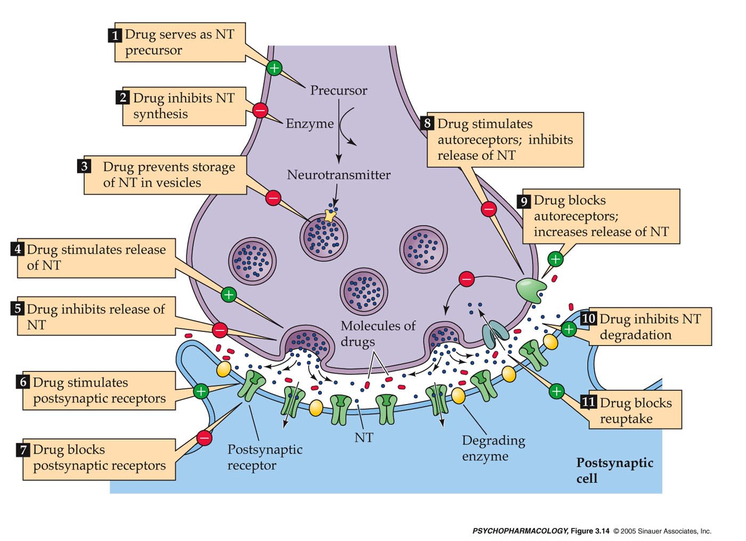
How drugs can alter neurotransmitter lifecycle
(agonist)
(antagonist)

Slide 50
How Drugs Can Affect Neurotransmitter Activity
Act as neurotransmitter precursor -
Inhibit NT synthesis -
Prevent storage of NT in vesicles -
Stimulate release of NT -
Inhibit release of NT -
Stimulate (i.e., bind to and activate) postsynaptic receptor -
Block postsynaptic receptor -
Stimulate autoreceptor -
Block autoreceptor -
Inhibit metabolism of NT -
Block reuptake (transporter) -
Notes:
This slide is just a spot for you to more easily take notes if you want to ☺

Slide 51
the Major neurotransmitter systems and synthesis sites
1) Dopamine (DA)
2) Norepinephrine (NE)
3) Serotonin (5-HT)
4) Glutamate
5) GABA
6) Acetylcholine (ACh)
7) Peptide hormones (incl. endogenous opioids)
8) Endocannabinoids
VTA - Ventral Tegmental Area
Substantia Nigra
Locus Coeruleus
Dorsal Raphe

Slide 52
One neuron … one neurotransmitter? Nope.
Some 100 neurotransmitters and counting…
Most, if not all neurons synthesize and release more than 1 neurotransmitter
Often physically separated from each other or released at different times/due to different stimulation
So, we are typically referring to the primary neurotransmitter released
Furthermore, neurotransmitters are everywhere in your body… not just your brain!

Slide 53
the nervous system
Brain Nucleus/
Nervous System
Body!

Slide 54
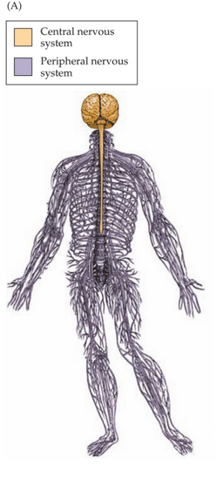
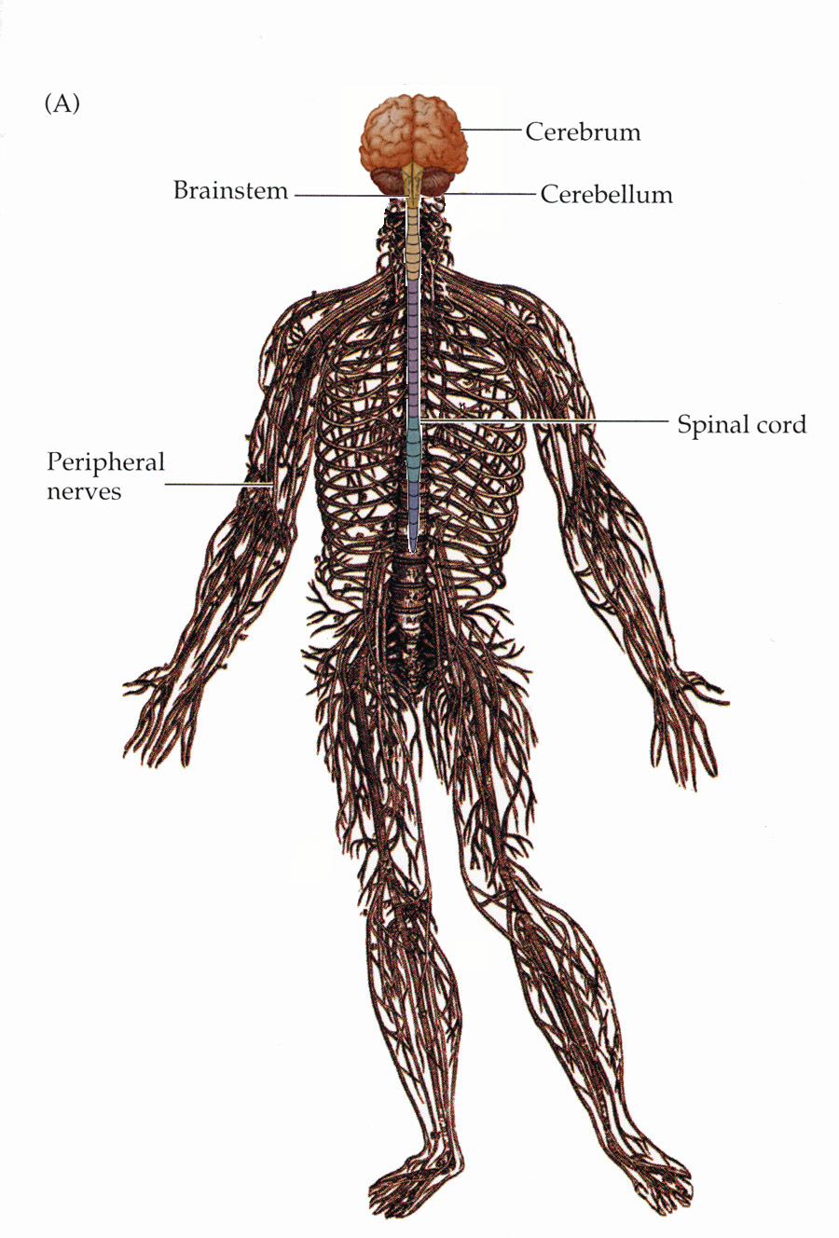
The nervous system has central and peripheral components

Slide 55
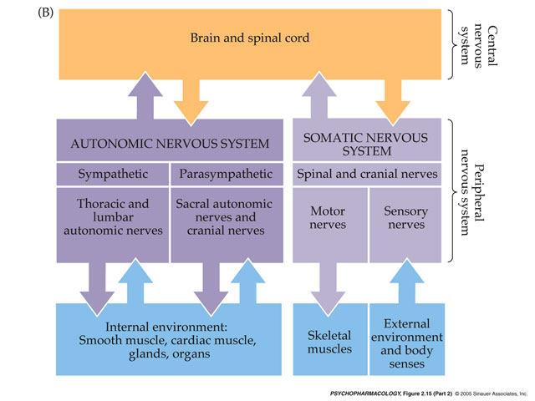
Major Divisions of the Nervous System

Slide 56
Central Nervous System
peripheral Nervous System
Consists of the brain and spinal cord.
Functions.
Integration of information.
Learning and memory.
Coordination of activity.
Nerves and nuclei (i.e., ‘ganglia’) that lie outside of the brain and spinal cord.
Functions depend on sub-system…

Slide 57
Major Divisions of the Nervous System
“Fight or flight” system
“Rest and digest” system

Slide 58
Autonomic Nervous System
Many psychoactive drugs affect the brain and the autonomic nervous system simultaneously
Uses feedback and feedforward loops to maintain homeostasis
Monitors and controls the body’s internal environment and involuntary functions.
Heart rate and blood pressure.
Two branches of the Autonomic Nervous system often act in opposition:
Sympathetic branch.
Example: Norepinephrine is involved in increasing heart rate.
“Fight-or-flight” response.
Parasympathetic branch.
Example: Acetylcholine is involved in decreasing heart rate.

Slide 59
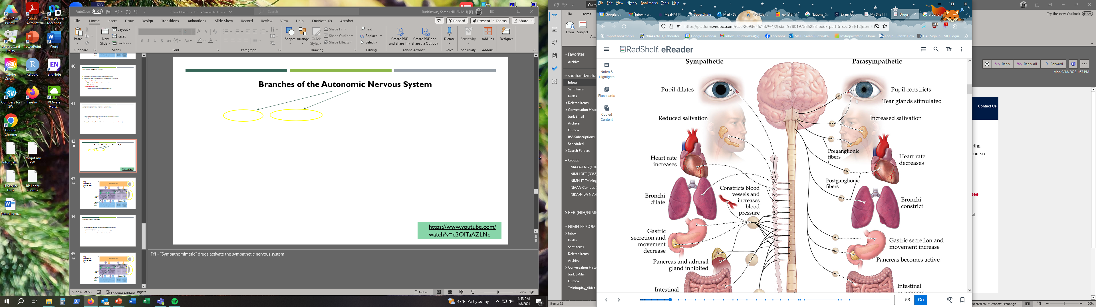
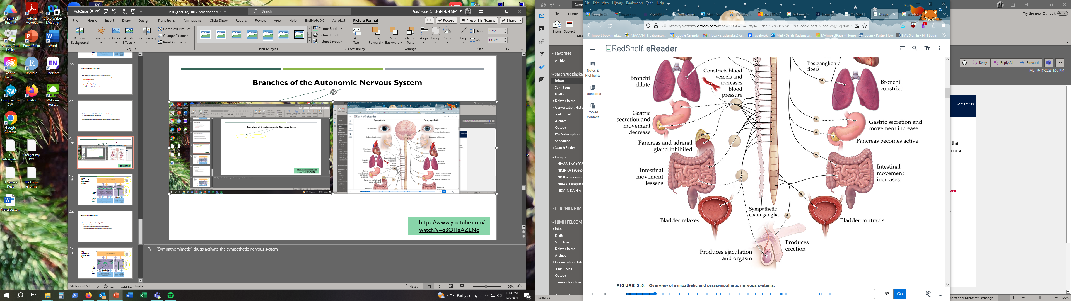
Branches of the Autonomic Nervous System
https://www.youtube.com/watch?v=q3OITaAZLNc
Notes:
FYI - “Sympathomimetic” drugs activate the sympathetic nervous system
Parasymp – “D” digestion, defecation, diuresis, dozing, downtime…

Slide 60
Major Divisions of the Nervous System
Interactions with
Interactions with

Slide 61
Somatic Nervous System
Nerve cells on the “front lines,” interacting with the external environment.
Controls voluntary actions.
Carries sensory information into the central nervous system, or CNS.
Carries motor, or movement, information back out to the peripheral nerves.

Slide 62
Major Divisions of the Nervous System
“Fight or flight” system
Interactions with
Interactions with
“Rest and digest” system

